Slide 1


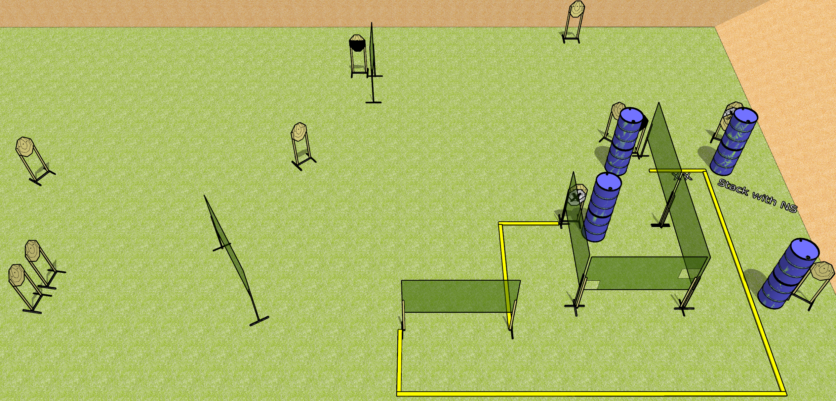
 | Dothan Gun Club – USPSA Match I Like Turtles Course Designer : Drew Coleman
Round Count 24 rounds 12 IPSC
Equipment List 9 wall feet 3 medium fault lines 1 upper third HC, 1 tuxedo

Slide 2
I Like Turtles
Written Stage Briefing
I Like Turtles is a 24 round, 120 point, Comstock course of fire. There are 12 IPSC targets. The best 2 hits on paper will score. The start signal is audible.
Handgun start position is both feet on X’s, facing uprange, wrists above shoulders. Handgun is loaded and holstered.
PCC start position is both feet on X’s, stock on belt. Carbine is loaded with safety on.
On start signal, engage targets as they become available from within the shooting area.

